Slide 1



University Institute of Engineering
DEPARTMENT OF COMPUTER SCIENCE & ENGINEERING
Subject Name: Software Engineering
Subject Code: 23CST-206
Er. Jagmeet Kaur
E8387
ASSISTANT PROFESSOR
CSE
DISCOVER . LEARN . EMPOWER

Slide 2
Topics covered
Interaction Diagram
Activity Diagram
State Chart Diagram

Slide 3
Interaction Diagram
The purpose of interaction diagram is −
To capture the dynamic behavior of a system.
To describe the message flow in the system.
To describe the structural organization of the objects.
To describe the interaction among objects.

Slide 4
Interaction Diagram
Following things are to be identified clearly before drawing the interaction diagram
Objects taking part in the interaction.
Message flows among the objects.
The sequence in which the messages are flowing.
Object organization.

Slide 5
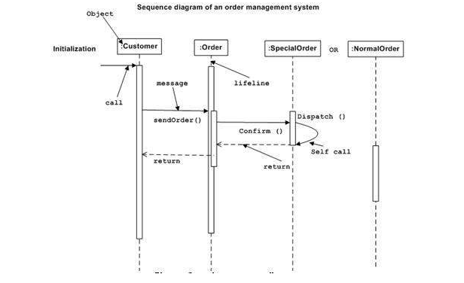
Interaction Diagram

Slide 6
Behavior Diagrams
Activity Diagrams
We use Activity Diagrams to illustrate the flow of control in a system.
We can also use an activity diagram to refer to the steps involved in the execution of a use case.
We model sequential and concurrent activities using activity diagrams. describe or depict what causes a particular event using an activity diagram.

Slide 7
Activity Diagram
The purpose of an activity diagram can be described as −
Draw the activity flow of a system.
Describe the sequence from one activity to another.
Describe the parallel, branched and concurrent flow of the system.

Slide 8
Activity Diagram
Activity diagrams are mainly used as a flowchart that consists of activities performed by the system. Activity diagrams are not exactly flowcharts as they have some additional capabilities. These additional capabilities include branching, parallel flow etc.
Before drawing an activity diagram, we should identify the following elements −
Activities
Association
Conditions
Constraints

Slide 9
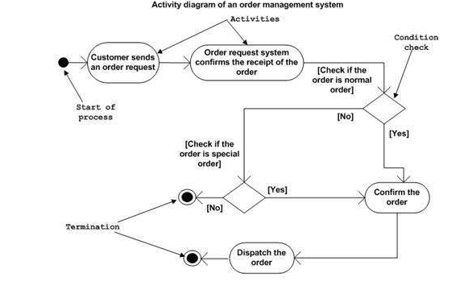
Activity Diagram
Following diagram is drawn with the four main activities −
Send order by the customer
Receipt of the order
Confirm the order
Dispatch the order

Slide 10
Activity Diagram
Activity diagram can be used for −
Modeling work flow by using activities.
Modeling business requirements.
High level understanding of the system's functionalities.
Investigating business requirements at a later stage.

Slide 11
State chart Diagram
State chart diagram is one of the five UML diagrams used to model the dynamic nature of a system. They define different states of an object during its lifetime and these states are changed by events
Following are the main purposes of using State chart diagrams −
To model the dynamic aspect of a system.
To model the life time of a reactive system.
To describe different states of an object during its life time.
Define a state machine to model the states of an object.

Slide 12
Behavior Diagrams
State Machine Diagrams
A state diagram is used to represent the condition of the system or part of the system at finite instances of time.
It’s a behavioral diagram and it represents the behavior using finite state transitions. State diagrams are also referred to as State machines and State-chart Diagrams .
These terms are often used interchangeably.
So simply, a state diagram is used to model the dynamic behavior of a class in response to time and changing external stimuli.

Slide 13
How to Draw a State chart Diagram?
State chart diagram is used to describe the states of different objects in its life cycle. Emphasis is placed on the state changes upon some internal or external events.
Before drawing a State chart diagram we should clarify the following points −
Identify the important objects to be analyzed.
Identify the states.
Identify the events.

Slide 14
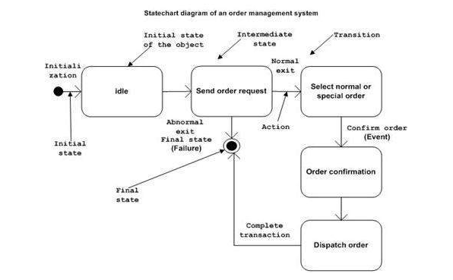
State Chart Diagram

Slide 15
Where to Use State chart Diagrams?
The main usage can be described as −
To model the object states of a system.
To model the reactive system. Reactive system consists of reactive objects.
To identify the events responsible for state changes.
Forward and reverse engineering.

Slide 16
REFERENCES
Reference Books:
Suman Ugrasen, “Software Engineering - Concepts and Practices”, First Edition, Cengage.
Mohammad Ali Shaikh, “Software Engineering with UML”, Third Edition, Notion Press.
Somerville Ian, “Software Engineering”, Addison Wesley, 8th Edition.
Text Books:
Pressman Rogers, “Software Engineering: A Practitioner's Approach”, Sixth edition. Patterson and Hennessy, “Computer Architecture” , Fifth Edition Morgaon Kauffman.
Rajib Mall, “Fundamentals of Software Engineering’’, Fourth Edition, Pearson, PHI.
Image References
https://www.geeksforgeeks.org/unified-modeling-language-uml-introduction/
https://www.uml.org/

Slide 17
THANK YOU

